Slide 1


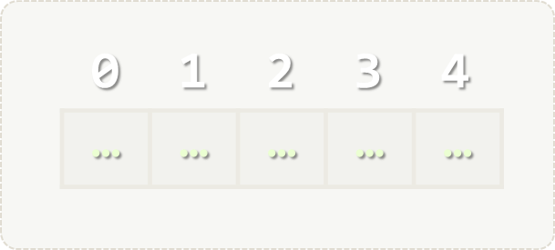

Lists
Processing Variable-Length Sequences of Elements
Lists
SoftUni Team
Technical Trainers
Software University
http://softuni.bg

Slide 2



Table of Contents
Lists Overview
Reading Lists from the Console
Printing Lists to the Console
List Manipulation
List Slicing
List Comprehension

Slide 3
Questions?
sli.do #python-fund

Slide 4
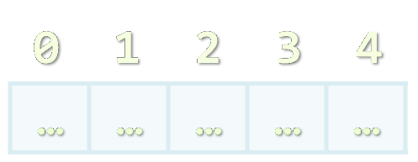
Lists Overview
List Definition, Operations

Slide 5
List – Overview
list holds a list of elements of any type
names = [] # Create an empty list
names.append("Peter") # Add an item
names.append("Maria")
names.append("George")
for name in names:
print(name)
names.remove("George") # Remove an item
print(", ".join(names)) # Peter, Maria

Slide 6
Accessing List Elements by Index
list[index] – returns the item using a zero-based index
Elements: [1, 2, 3, 4, 5]
Indices: 0 1 2 3 4
Python supports negative indices:
nums = [15, 12, 13, 16, 1]
first_element = nums[0] # 15
nums = [15, 12, 13, 16, 1]
last_element = nums[-1] # 1
third_to_last_element = nums[-3] # 13

Slide 7
List – Functionality
Provides the following operations:
[el1, el2, …] – creates a list with the given items
len(list) – returns the number of items in a list
list1 + list2 – concatenates the given lists
nums = [1, 2, 3]
print(len(names)) # 3
names = ['pesho', 'gosho']
more_names = ['ivan', 'stamat']
print(names + more_names)
# ['pesho', 'gosho', 'ivan', 'stamat']

Slide 8
List – Functionality (2)
Provides the following operations:
list * number – replicates the list a number of times
element in list – determines whether an item is in the list
for element in list: – iterates trough the list’s items
nums = [1, 2] * 4 # [1, 2, 1, 2, 1, 2, 1, 2]
is_two_present = 2 in nums # True
for num in nums:
print(num)

Slide 9
List – Functionality (3)
Provides the following operations:
enumerate(list) – enumerates the list’s indices
The resulting collection is a list of tuples
Tuple == ordered finite collection
(double, triple, quadruple, quintuple, sextuple, septuple, etc.)
nums = [50, 100]
for (index, num) in enumerate(nums):
print('list[{}] -> {}'.format(index, num))
# list[0] -> 50
# list[1] -> 100

Slide 10
List – Miscellaneous Operations
max/min(list) – returns the item with the largest/smallest value from the list:
sum(list) – returns the sum of all elements in the list:
nums = [1, -2, 66, 4, 5]
largest_element = max(nums) # 66
smallest_element = min(nums) # -2
nums = [1, 2, 3, 4, 5]
summed = sum(nums) # 15

Slide 11

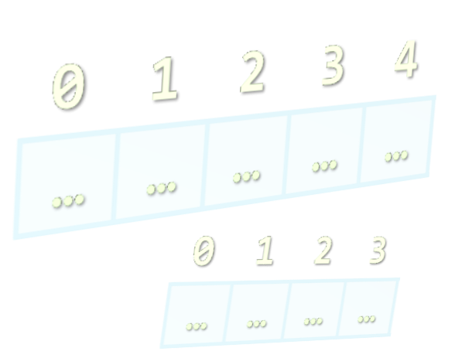
Reading Lists from the Console

Slide 12
Reading Lists from the Console
Read the length from the console:
Next, create a list n and read its elements:
n = int(input())
nums = []
for i in range(n):
list.append(int(input()))

Slide 13
Reading List Values from a Single Line
Lists can be read from a single line of space separated values:
2 8 30 25 40 72 -2 44 56
string.split(' ') splits a string by space and creates a list
values = input()
items = values.split(' ')
nums = []
for i in items:
nums.append(int(i))

Slide 14
Printing Lists on the Console
Printing a list using a for-loop:
Printing a list using string.join(…):
nums = ["one", "two", "three", "four", "five", "six"]
for i in nums:
print(i)
nums = ["one", "two", "three", "four", "five", "six"]
print("; ".join(nums))
# one; two; three; four; five; six

Slide 15

List Manipulation
Adding/Removing/Finding elements

Slide 16
List – Functions
Provides the following functions:
list.append(item) – adds the item in the end of the list
list.insert(index, item)– inserts the item at the index
nums = [1, 2, 3]
nums.append(4) # [1, 2, 3, 4]
nums = [1, 2, 3]
nums.insert(0, 4) # [4, 1, 2, 3]

Slide 17
List – Functions (2)
Provides the following functions:
list.pop() – removes and returns the last occurrence of item
list.count(item) – returns the number of occurences of item
nums = [1, 2, 3]
last_num = nums.pop() # 3
print(nums) # [1, 2]
nums = [1, 2, 3, 3, 3, 3, 2, 1]
nums.count(3) # 4

Slide 18
List – Functions (2)
Provides the following functions:
list.index(item) – returns first occurrence index of item
list.remove(item) – removes the first occurence of item
Both functions raise ValueError if the item is not found
nums = [44, 56, 23]
num_index = nums.index(56) # 1
nums = [1, 2, 3, 3, 3, 3, 2, 1]
nums.remove(2) # [1, 3, 3, 3, 3, 2, 1]

Slide 19
List – Item Order Functions
Provides the following operations:
list.reverse() – reverses the list
list.sort() – sorts the list in ascending order
list.sort(reverse=True) – sorts the list in descending order
nums = [44, 56, 23]
nums.reverse() # [23, 56, 44]
nums = [3, 1, 2]
nums.sort() # [1, 2, 3]
nums = [3, 1, 2]
nums.sort(reverse=True) # [3, 2, 1]

Slide 20



List Slicing

Slide 21
List Slicing
We can use the list slicing notation to quickly get part of a list
Slice notation – list[startIndex:stopIndex:step]
Slice notation with step:
List slicing also works with strings
nums = [44, 56, 23, 33, 12, 55, 112]
sliced_nums = nums[1:4] # [56, 23, 33]
nums = [1, 2, 3, 4, 5, 6, 7, 8, 9, 10]
sliced_nums = nums[0:9:2] # [1, 3, 5, 7, 9]

Slide 22
List Slicing – Optional Parameters
List slicing parameters are optional
Skipping stop parameter:
Skipping start and stop parameters and just using step:
nums = [1, 2, 3, 4, 5]
sliced_nums = nums[2:] # [3, 4, 5]
nums = [1, 2, 3, 4, 5]
sliced_nums = nums[::2] # [1, 3, 5]
reversed_nums = nums[::-1] # [5, 4, 3, 2, 1]

Slide 23
List Slicing – Optional Parameters (2)
List slicing parameters are optional
Skipping stop and using step:
Skipping start :
nums = [1, 2, 3, 4, 5]
sliced_nums = nums[2::-1] # [3, 2, 1]
nums = [1, 2, 3, 4, 5]
sliced_nums = nums[:3] # [1, 2, 3]

Slide 24


List Comprehension

Slide 25
List Comprehension
We can use list comprehension to manipulate lists easily
Using a for loop
Using a list comprehension – [value for item in items]
nums = [1, 2, 3, 4, 5]
squared_nums = []
for num in nums:
squared_nums.append(num * num) # [2, 4, 6, 8, 10]
nums = [1, 2, 3, 4, 5]
squared_nums = [num * num for num in nums]
# [2, 4, 6, 8, 10]

Slide 26
List Comprehension – If Statements
We can use conditions in list comprehensions
Using a for loop
Using a list comprehension – [value for item in items]
nums = [1, 2, 3, 4, 5]; squared_nums = []
for num in nums:
if num % 2 == 1:
squared_nums.append(num * num) # [1, 9, 25]
nums = [1, 2, 3, 4, 5]
squared_nums = [num * num for num in nums if num % 2 == 1]
# [1, 9, 25]

Slide 27

Lists – Exercises
Live Exercises in Class (Lab)

Slide 28
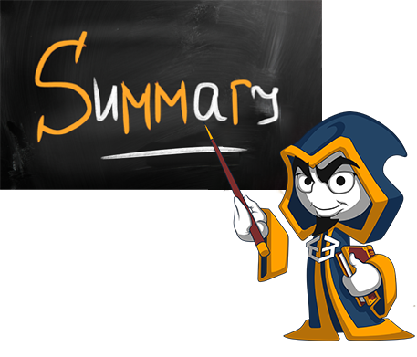
Summary
Lists hold a variable-length sequence of elements
Can add / remove / insert elements at runtime
Creating a list:
Accessing list elements by index:
Printing list elements:
nums = []
nums = [1, 2, 3]
nums[5] = 10
print(', '.join(nums))

Slide 29







Lists
https://softuni.bg/opencourses/python-fundamentals-course

Slide 30

License
This course (slides, examples, demos, videos, homework, etc.) is licensed under the "Creative Commons Attribution-NonCommercial-ShareAlike 4.0 International" license
Attribution: this work may contain portions from
"Fundamentals of Computer Programming with C#" book by Svetlin Nakov & Co. under CC-BY-SA license

Slide 31





Trainings @ Software University (SoftUni)
Software University – High-Quality Education, Profession and Job for Software Developers
softuni.bg
Software University Foundation
http://softuni.foundation/
Software University @ Facebook
facebook.com/SoftwareUniversity
Software University Forums
forum.softuni.bg

